Slide 1



Retail Analysis
View in Power BI
Last data refresh:
9/28/2023 3:29:07 PM UTC
Downloaded at:
2/29/2024 11:09:46 PM UTC

Slide 2
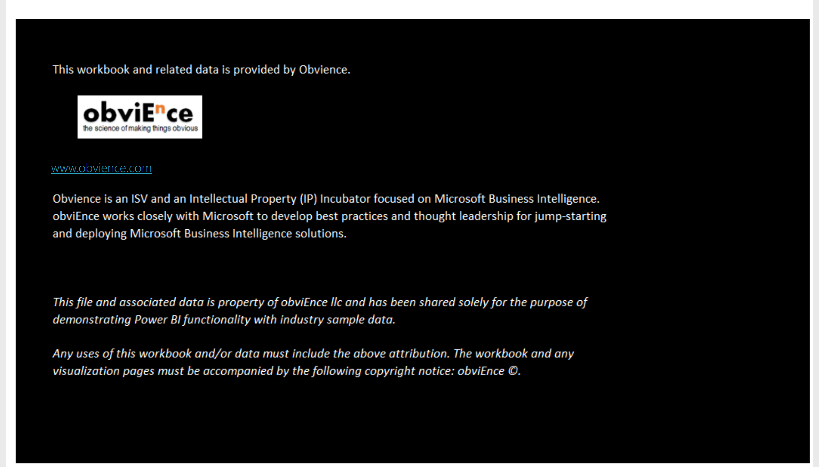
Info
Notes:
image
No alt text provided
textbox
No alt text provided

Slide 3
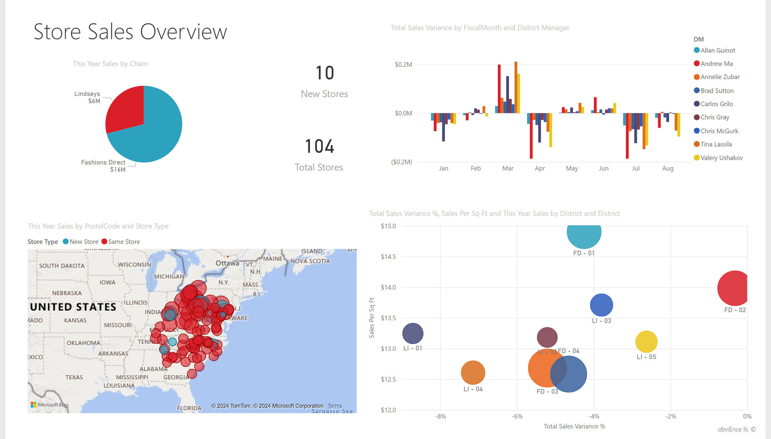
Overview
Notes:
textbox
No alt text provided
card
No alt text provided
map
No alt text provided
textbox
No alt text provided
Total Sales Variance by FiscalMonth and District Manager
No alt text provided
pieChart
No alt text provided
scatterChart
No alt text provided
card
No alt text provided

Slide 4
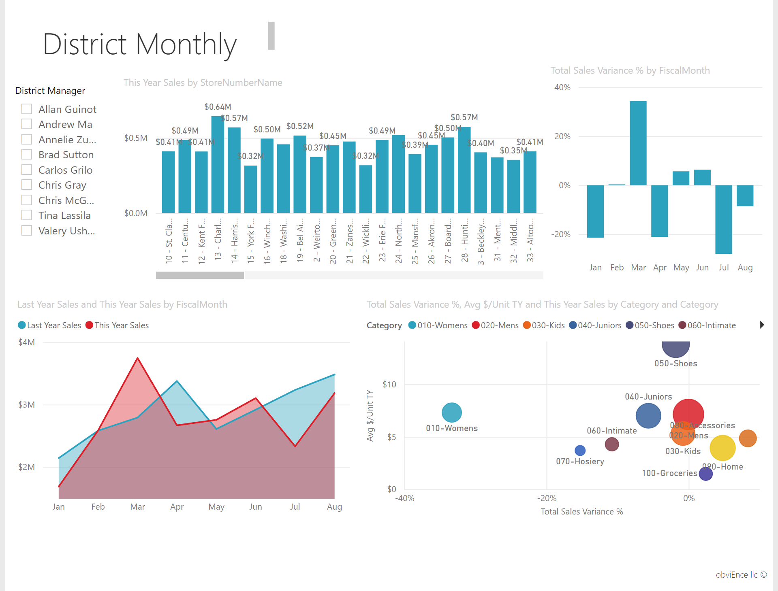
District Monthly Sales
Notes:
textbox
No alt text provided
clusteredColumnChart
No alt text provided
textbox
No alt text provided
areaChart
No alt text provided
scatterChart
No alt text provided
clusteredColumnChart
No alt text provided
District Manager
No alt text provided

Slide 5
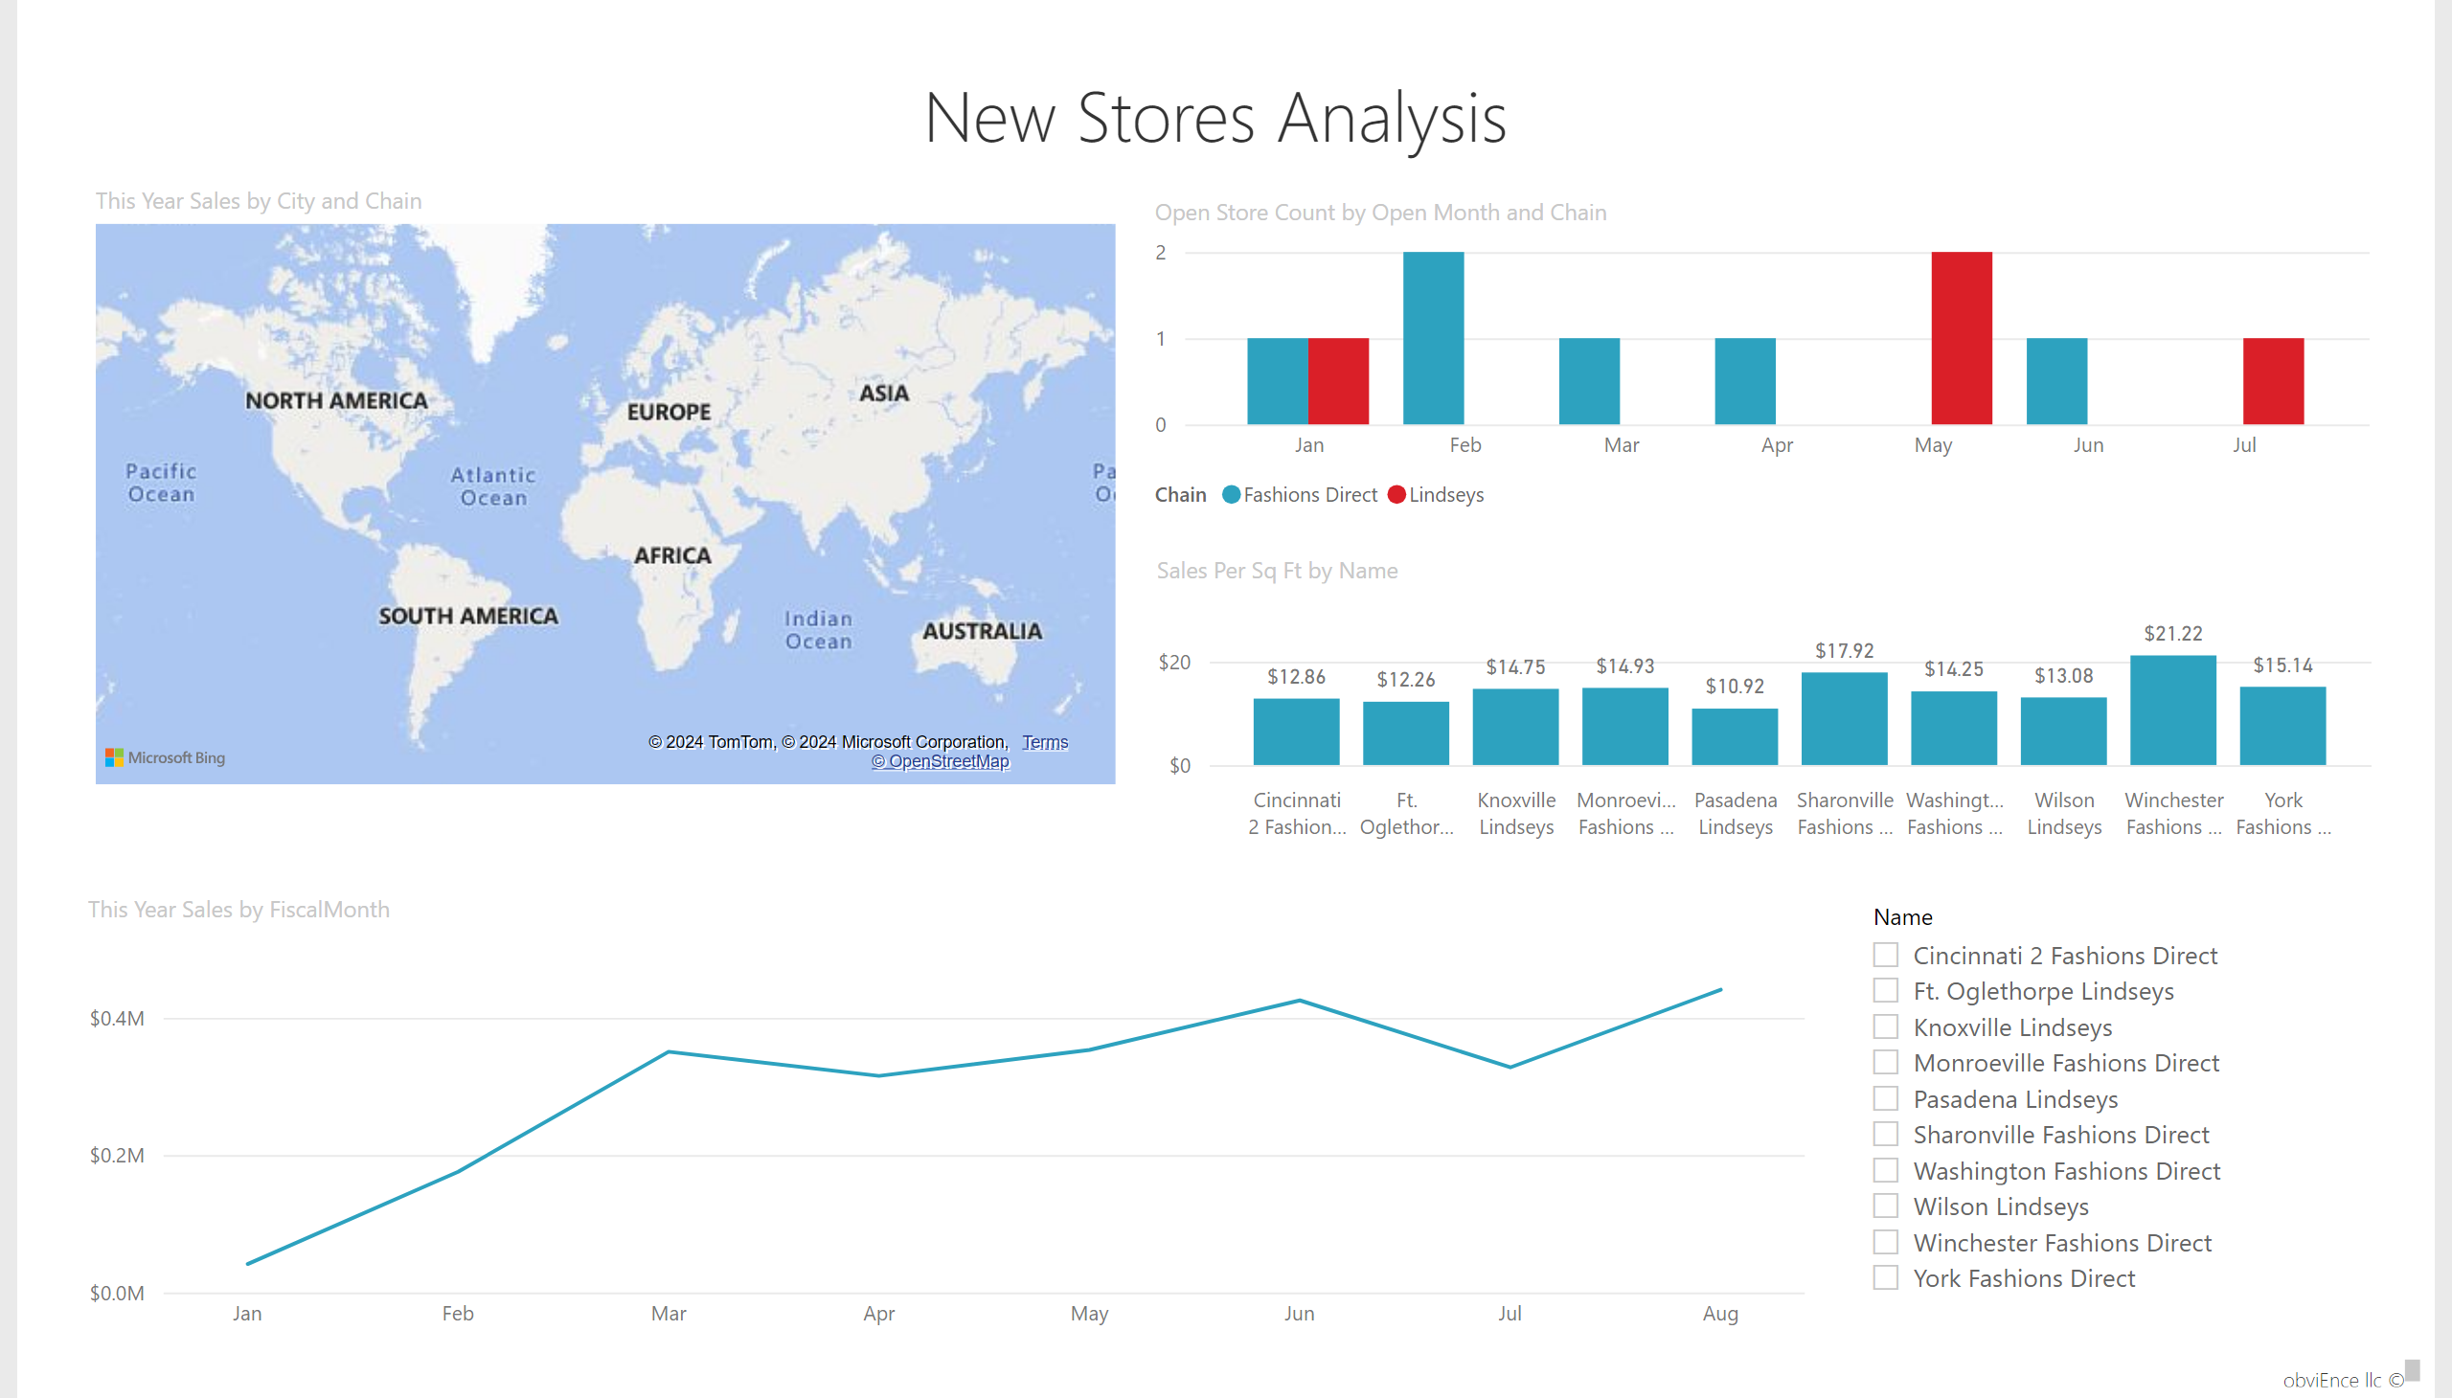
New Stores
Notes:
textbox
No alt text provided
lineChart
No alt text provided
clusteredColumnChart
No alt text provided
map
No alt text provided
columnChart
No alt text provided
textbox
No alt text provided
slicer
No alt text provided

